Slide 1

Introduction to Phishing Attacks
Phishing is a type of cybercrime that uses deceptive tactics to steal your personal information. Hackers impersonate trusted entities like banks or government agencies to trick you into revealing your sensitive data.
by SHIVAM JOSHI

Slide 2
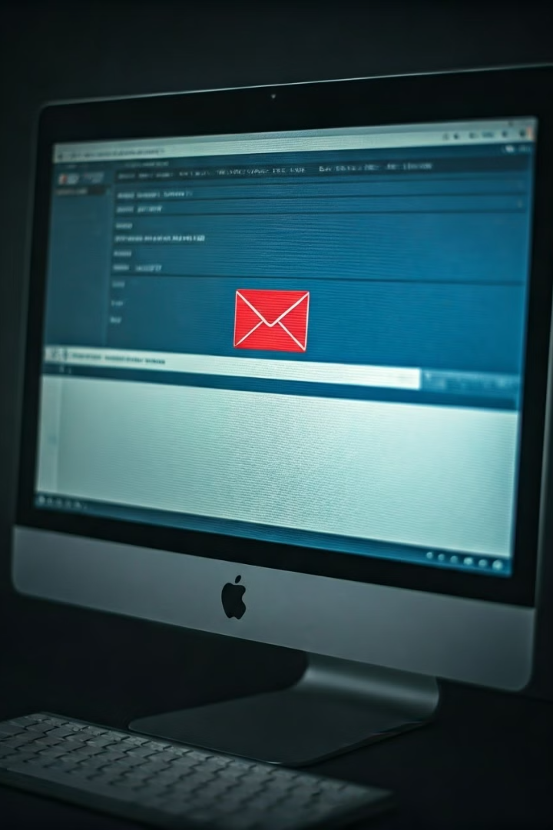
Definition of Phishing
Phishing involves using deceptive emails, texts, or websites to trick people into giving up sensitive information such as login credentials, credit card details, or personal data. This information is then used to steal money, identity, or compromise accounts.
Objective
Method
To gain access to your sensitive information.
Deception and impersonation of trusted entities.
Targets
Individuals and organizations.

Slide 3
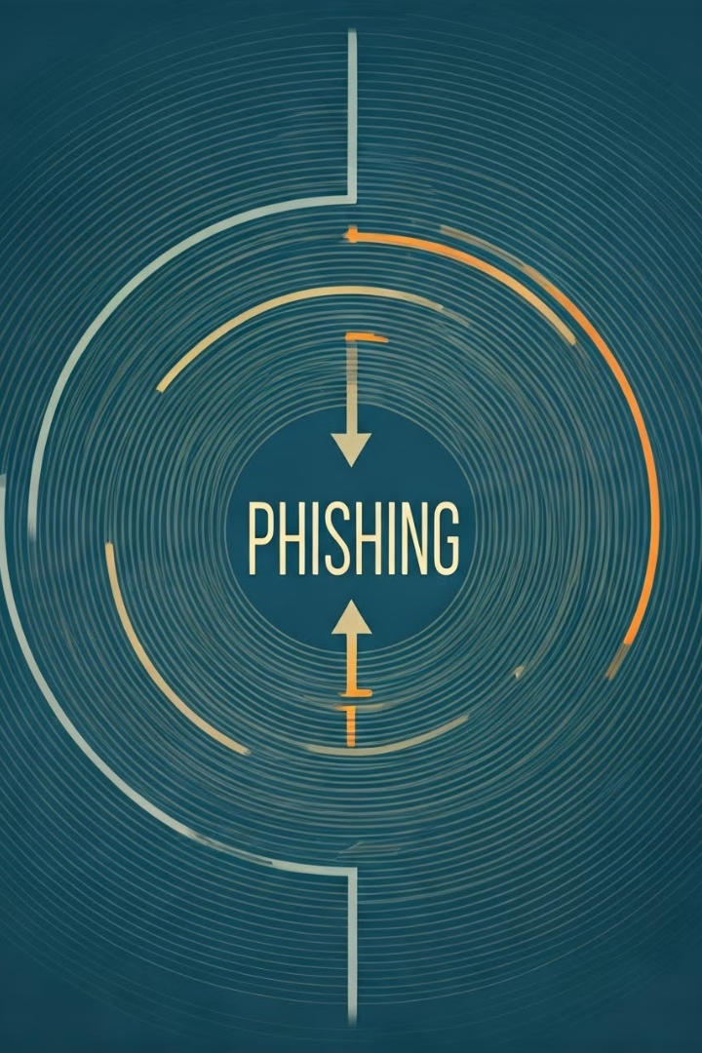
Types of Phishing Attacks
Phishing attacks can take on various forms, each employing different tactics to deceive their victims.
1
Spear Phishing
2
Whaling
Targeted attacks focused on specific individuals or organizations.
High-profile targets like CEOs or executives.
3
Smishing
4
Vishing
Phishing attempts via SMS messages.
Phishing attacks conducted over the phone.

Slide 4

Anatomy of a Phishing Attack
Understanding the anatomy of a phishing attack is crucial for recognizing and avoiding them.
1
Bait
The initial lure, often a compelling email, text, or website.
2
Hook
The deceptive element that tricks the victim into taking action.
3
Line
The pathway used to steal the victim's information.
4
Catch
The successful acquisition of sensitive information.

Slide 5
Real-Life Phishing Examples
Real-life phishing examples highlight the diverse tactics used by attackers. It's crucial to be aware of these examples to protect yourself.
Fake Account Recovery
Fake Shipping Notifications
Fake Invoice Scams
An email claiming to be from a popular social media platform, prompting users to reset their password.
A text message claiming to be from a shipping company, asking for your tracking information.
A deceptive email claiming to be an invoice from a vendor, prompting you to download a malicious file.

Slide 6
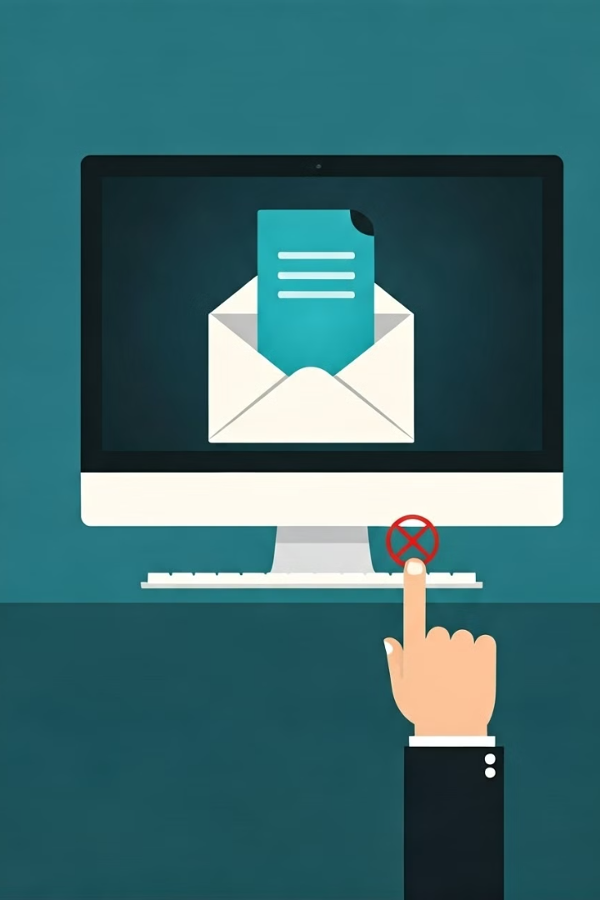
Identifying Phishing Attempts
Identifying phishing attempts is crucial to prevent becoming a victim. There are telltale signs to look out for.
Suspicious Sender
Unfamiliar sender or sender address.
Urgent Tone
Emails or texts that demand immediate action.
Links or Attachments
Suspicious links or attachments that seem out of place.
Grammatical Errors
Poor grammar or spelling mistakes.

Slide 7
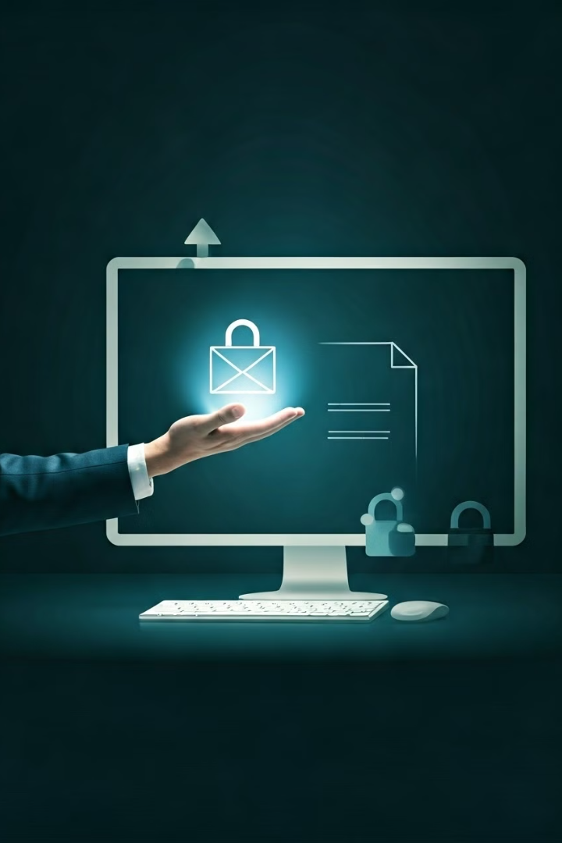




Protecting Yourself from Phishing
Staying vigilant and implementing preventative measures can significantly reduce your risk of falling victim to phishing attacks.
Be Skeptical
Don't blindly trust emails, texts, or websites.
Verify Information
Double-check the source of any suspicious communication.
Use Strong Passwords
Create complex passwords and avoid using the same one for multiple accounts.
Install Security Software
Use antivirus and anti-malware software to protect your devices.

Slide 8





Reporting Phishing Incidents
Reporting phishing incidents is crucial for raising awareness and protecting others from becoming victims.
Report to the Company
Report to Authorities
Contact the company you believe is being impersonated.
Contact the authorities responsible for cybercrime.
Forward Phishing Emails
Report Phishing Websites
Forward suspicious emails to the appropriate authorities.
Report phishing websites to the relevant organizations.

Slide 9

Consequences of Falling for Phishing
Falling for phishing attacks can have severe consequences, ranging from financial loss to identity theft.
1
Financial Loss
2
Identity Theft
Hackers can steal money from bank accounts or credit cards.
Stolen personal information can be used to impersonate you.
3
Data Breaches
4
Reputational Damage
Compromised accounts can lead to data breaches and security vulnerabilities.
Phishing attacks can damage your reputation and credibility.

Slide 10
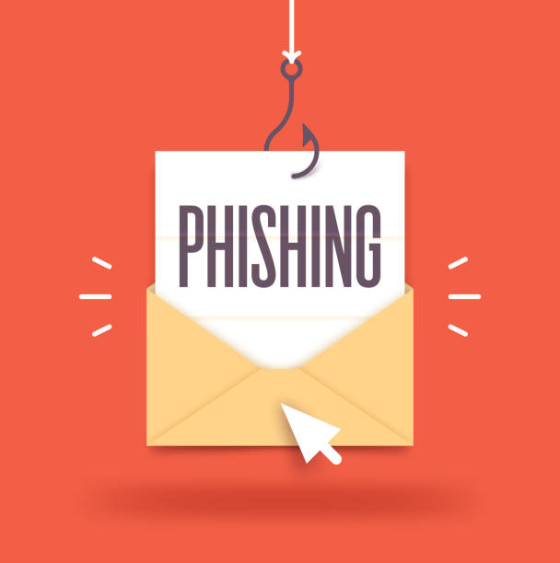
REAL LIFE EXAMPLES
Google and Facebook Scam
In 2017, a Lithuanian man tricked Google and Facebook into wiring over $100 million through phishing emails.
W-2 Data Breach
In 2016, an employee at Seagate fell victim to a phishing scam, resulting in the exposure of thousands of employees' W-2 information.
Business Email Compromise
The CEO of an Austrian aerospace parts manufacturer was targeted in a phishing attack, leading to a $54 million loss in 2016.

Slide 11
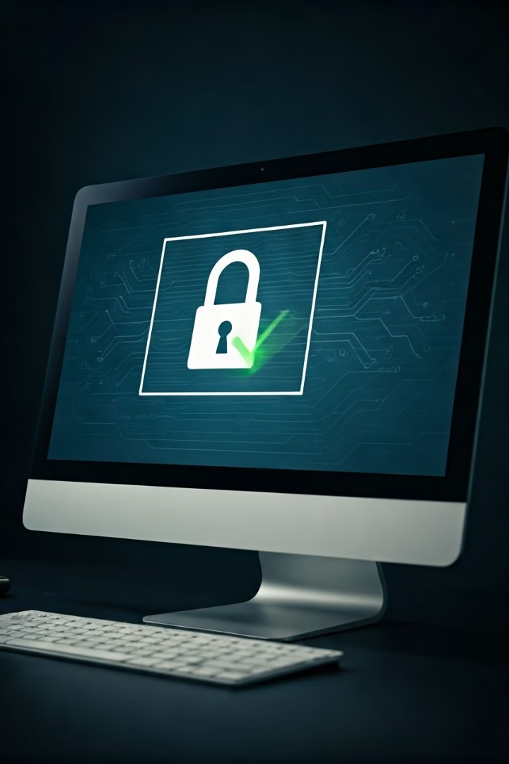
Conclusion and Best Practices
Phishing attacks are a persistent threat, but by being vigilant and practicing safe online habits, you can effectively protect yourself.
Stay Informed
Be Cautious
Stay updated on the latest phishing tactics and best practices.
Exercise caution when opening emails, clicking links, or downloading attachments.
Use Multi-Factor Authentication
Enable multi-factor authentication for all your online accounts.

